Slide 1
Community Collaboration SharePoint Site Overview
Business & Academic Platforms - SharePoint

Slide 2
Community Collaboration Sharepoint Site Overview
Contents
How to Access Community Collaboration SharePoint Site
Review of Site Dashboard
Review of Project Form
How to Delete Projects Not Carrying Over into 2016-2017
Approving/Rejecting Project Submissions
Sample Emails

Slide 3
Community Collaboration Sharepoint Site Overview
How to Access Community Collaboration SharePoint Site
Community Outreach URL: http://www.nova.edu/community-outreach/community-collaboration-database.html

Slide 4
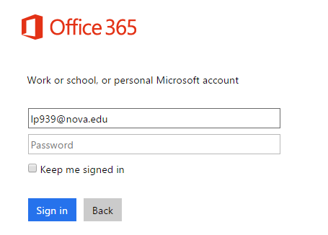
Community Collaboration Sharepoint Site Overview
How to Access Community Collaboration SharePoint Site, cont.
Enter your NSU Email Address; then press the tab button

Slide 5
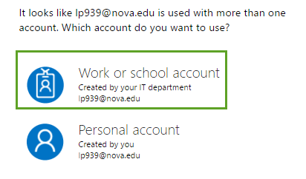
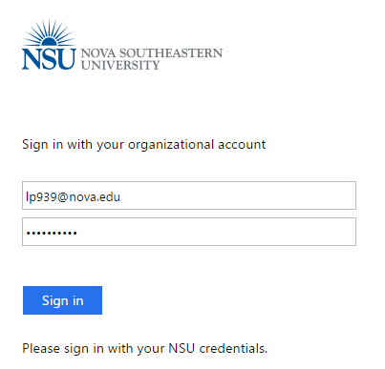
Community Collaboration Sharepoint Site Overview
How to Access Community Collaboration SharePoint Site, cont.
Next, select the “Work or School account” option
Finally, enter your NSU Email Address and Password to log into the Site

Slide 6
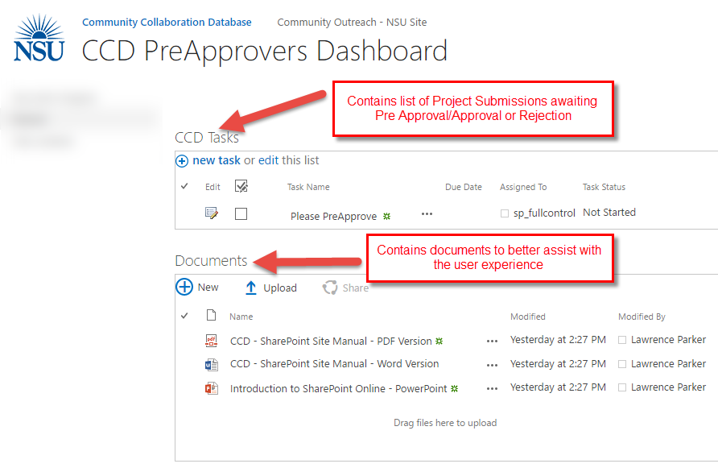
Community Collaboration Sharepoint Site Overview
Review of Site dashboard

Slide 7
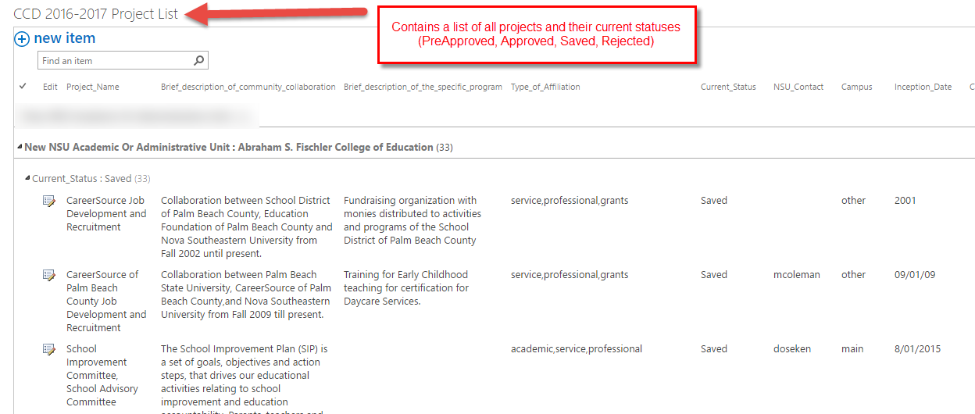
Community Collaboration Sharepoint Site Overview
Review of Site dashboard, cont.

Slide 8
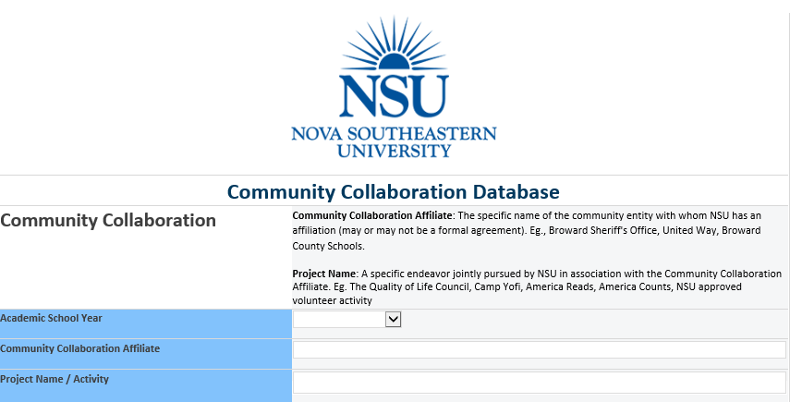
Community Collaboration Sharepoint Site Overview
Review of Project form

Slide 9
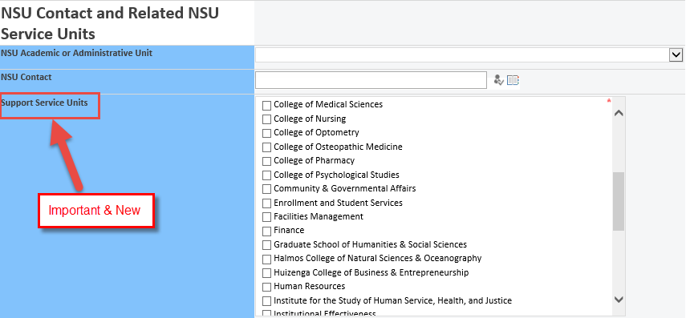
Community Collaboration Sharepoint Site Overview
Review of Project form, cont.

Slide 10
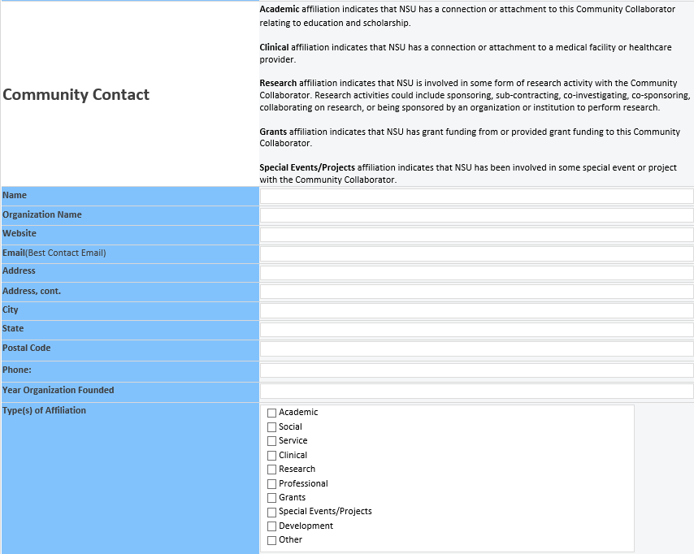
Community Collaboration Sharepoint Site Overview
Review of Project form, cont.

Slide 11
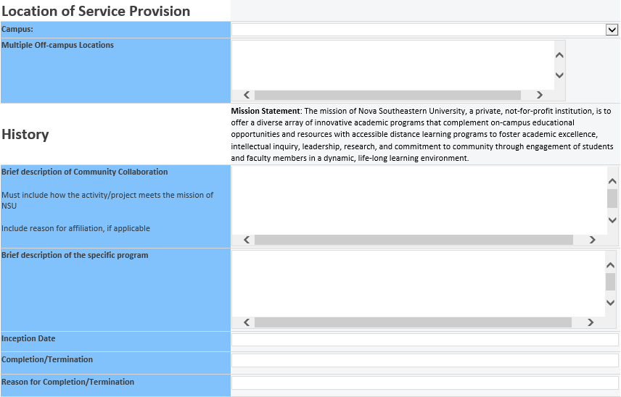
Community Collaboration Sharepoint Site Overview
Review of Project form, cont.

Slide 12
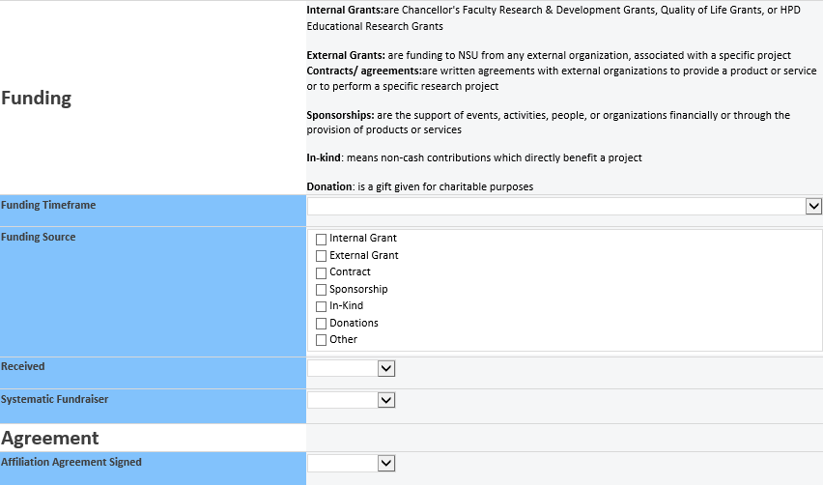
Community Collaboration Sharepoint Site Overview
Review of Project form, cont.

Slide 13
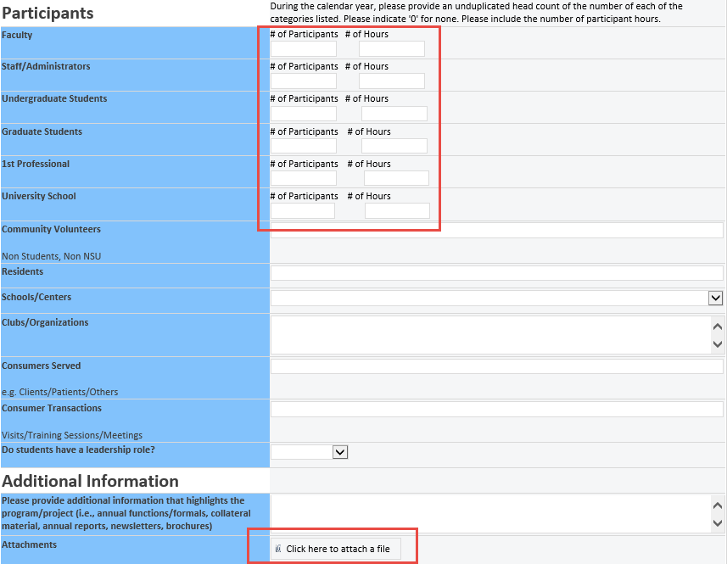
Community Collaboration Sharepoint Site Overview
Review of Project form, cont.

Slide 14
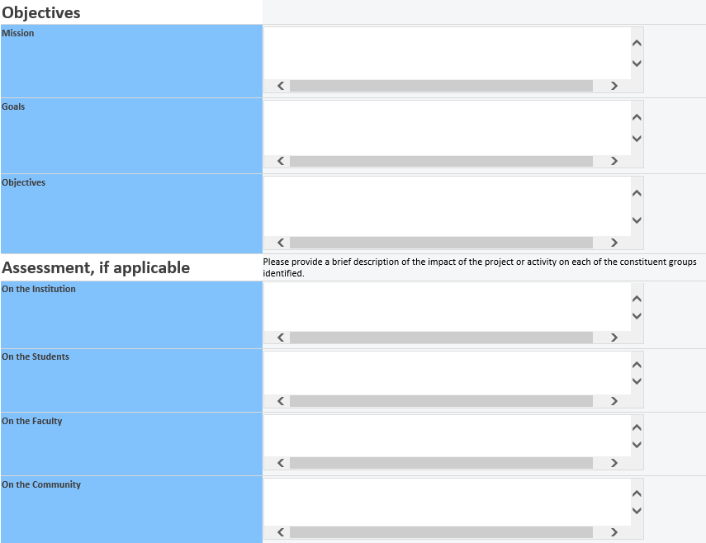
Community Collaboration Sharepoint Site Overview
Review of Project form, cont.

Slide 15
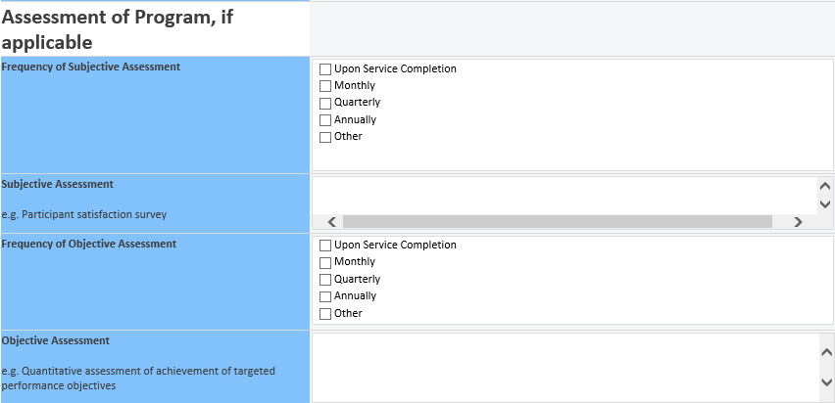
Community Collaboration Sharepoint Site Overview
Review of Project form, cont.

Slide 16
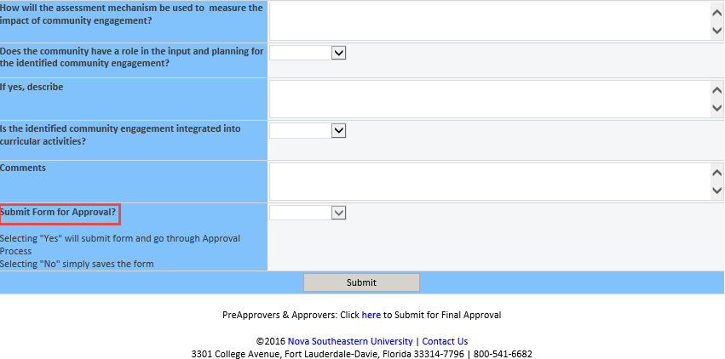
Community Collaboration Sharepoint Site Overview
Review of Project form, cont.

Slide 17
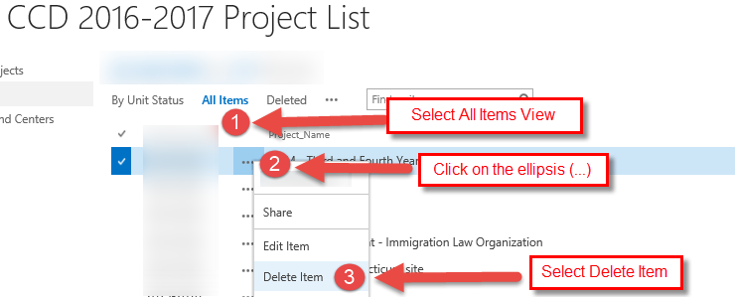
Community Collaboration Sharepoint Site Overview
How to Delete Projects Not Carrying Over into 2016-2017

Slide 18
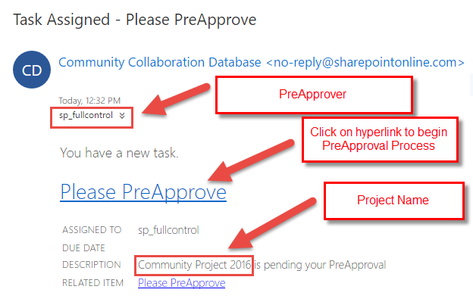
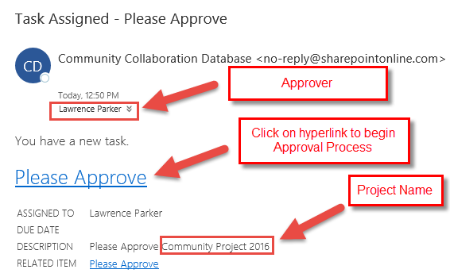
Community Collaboration Sharepoint Site Overview
Approving/Rejecting Project Submissions
PreApprover & Approver Task Emails

Slide 19
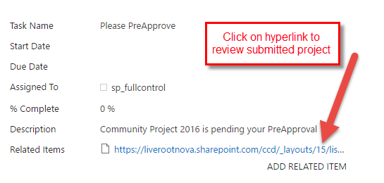
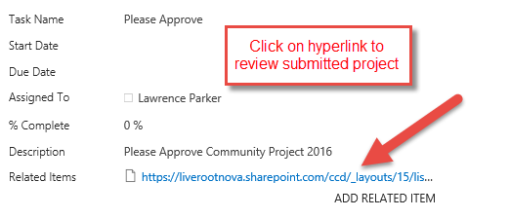
Community Collaboration Sharepoint Site Overview
Approving/Rejecting Project Submissions, cont.
PreApprover & Approver Task Information

Slide 20
Community Collaboration Sharepoint Site Overview
Approving/Rejecting Project Submissions, cont.
Review Submitted Project

Slide 21
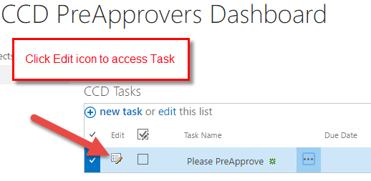
Community Collaboration Sharepoint Site Overview
Approving/Rejecting Project Submissions, cont.
Access Task to Update Project Status

Slide 22
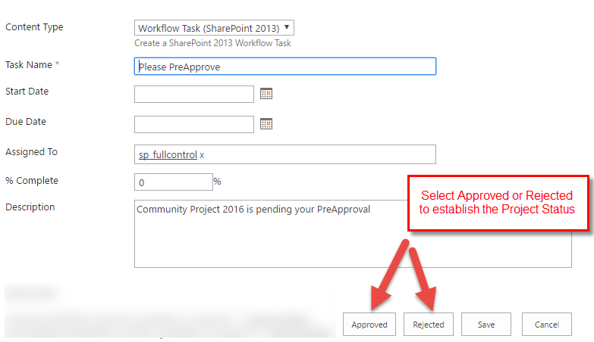
Community Collaboration Sharepoint Site Overview
Approving/Rejecting Project Submissions, cont.
Confirm Project Status

Slide 23
Community Collaboration Sharepoint Site Overview
Sample emails
Email Sent after PreApprover approves Project
Email Sent after Approver approves Project

Slide 24
Community Collaboration Sharepoint Site Overview
QUESTIONS & ANSWERS

